Slide 1

Cryptocurrency Pricing
Jimmy Nunnally
UMBC
Data 606 Spring 2020
Deliverable 2

Slide 2
Recap/Data Update
Predicting short term pricing for Ethereum
Pulled from numerous sources:
A collection from Bitfinex (primary focus)
60sec collection rate
Computationally expensive due to high granularity
Ethereum Blockchain
Full blockchain accessed from Google Big query
Retrieved CSV’s from above source
Over 700Million rows from transaction table
Aggregate pricing data from coinmarket cap
Google trend data

Slide 3
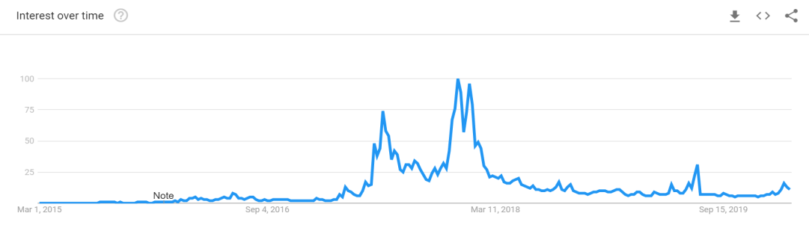
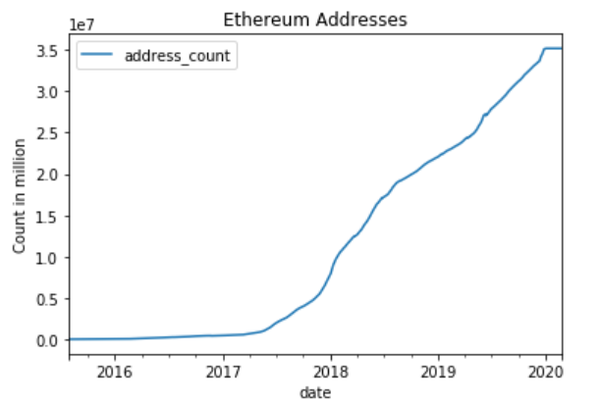
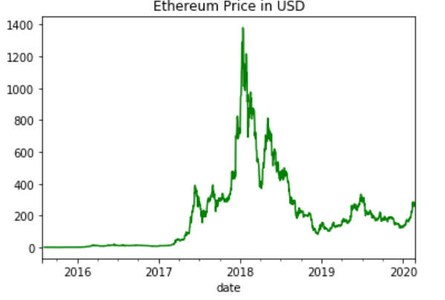
Exploratory data analysis
High level Etheream details, for full EDA please see the notebook at: https://github.com/JimmyNunnally/DATA_606

Slide 4
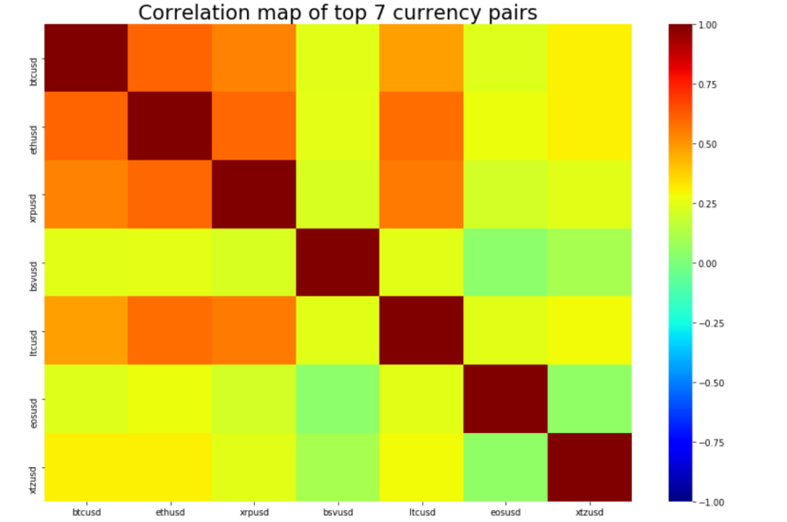
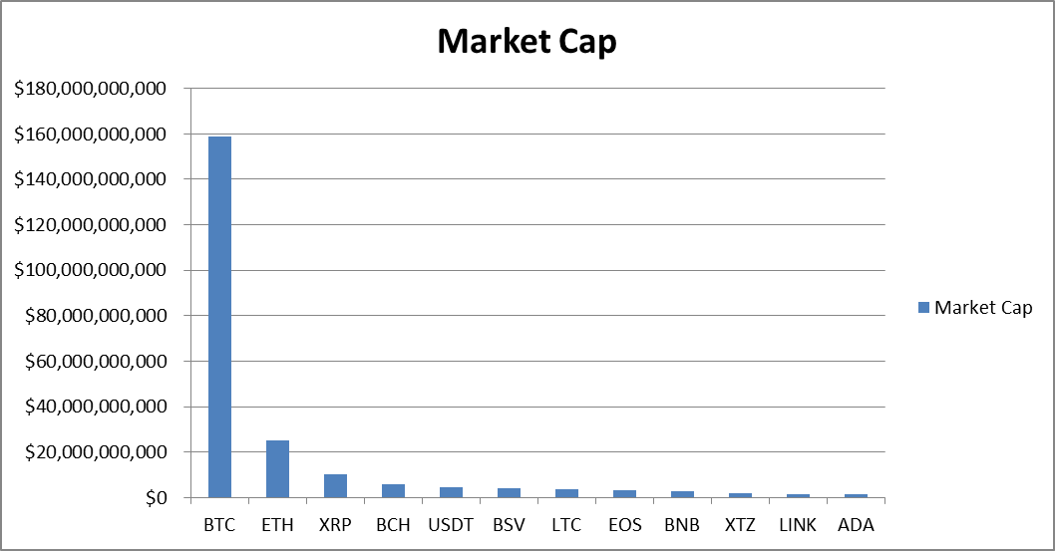
Currency Pairs
Other cyptocurrencies correlation weakens to Ethereum the further away we get from Ethereum’s market cap. The figure to the right shows the market caps of the top 7 cryptos

Slide 5
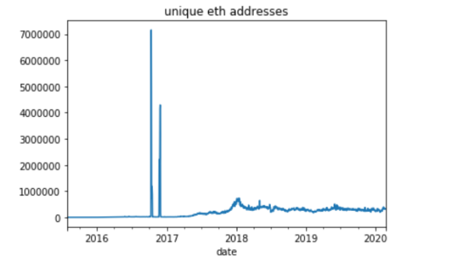
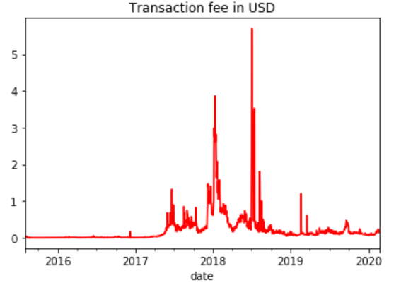
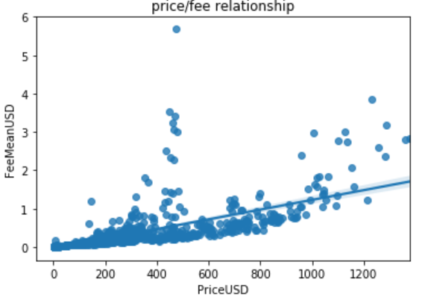
Other interesting findings
Spike due to DDOS attack
Spikes are during bullruns
Transaction fees correlate with price, can they predict change in price?

Slide 6
Similar projects
There are a lot!
They are professional, mainly done by fintech firms or research institutions (links at the end)
Fintech crypto pricing models are typically locked behind a steep paywall
There is a lot to learn from some of the research papers
None of the projects link to the data…

Slide 7
Comparable #1
“The digital traces of bubbles: feedback cycles between socio-economic signals in the Bitcoin economy”
Pulled social media data and aggregated exchange data
“This combined analysis reveals two positive feedback loops: a reinforcement cycle between search volume, word of mouth and price (social cycle), and a second cycle between search volume, number of new users and price (user adoption cycle). ”

Slide 8
Comparable #2
“Predicting short-term Bitcoin price fluctuations from buy and sell orders”
This study used data from the Okcoin exchange.
Hourly collection rate
Bid/Ask and volume plus derived calculations
Built numerous models from multiple methods
Claims some measure of success with a recommendation to use Extreme Gradient Tree for machine learning

Slide 9
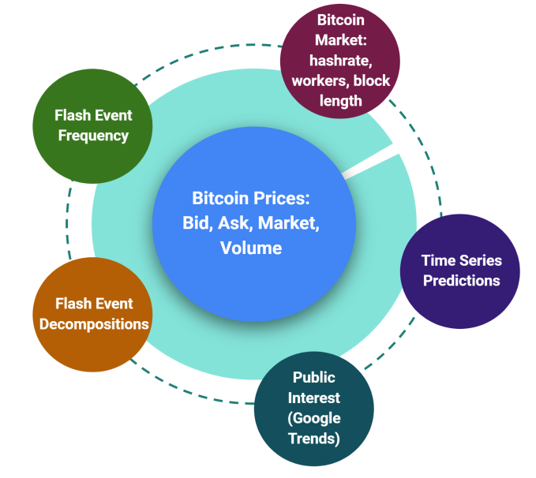
Honorable mention
Coinpredictor: A 2018 4 person Berkley capstone project
As best as I can tell the model displayed on their site is no longer operational
They did have some useful explanations in their PowerPoint
Inputs similar to my dataset
They used random-forest for prediction
Model inputs
Notes:
Most similar, but details unknown. Not really sure what they did

Slide 10
References: Data
https://www.kaggle.com/tencars/bitfinexdataset
https://trends.google.com/trends/explore?date=today%205-y&q=Ethereum
https://bigquery.cloud.google.com/table/bigquery-public-data:crypto_ethereum
https://coinmarketcap.com/

Slide 11
References
https://www.ischool.berkeley.edu/projects/2018/coinpredictor-one-stop-bitcoin-insights-tool
https://medium.com/google-cloud/plotting-ethereum-address-growth-chart-55cc0e7207b2
https://bitinfocharts.com/cryptocurrency-charts.html
https://medium.com/@100trillionUSD/modeling-bitcoins-value-with-scarcity-91fa0fc03e25
https://www.reddit.com/r/CryptoCurrency/comments/7n47be/i_built_these_3_fundamental_valuation_models_for/
https://royalsocietypublishing.org/doi/10.1098/rsif.2014.0623#RSIF20140623F1
https://www.researchgate.net/publication/323141771_Predicting_short-term_Bitcoin_price_fluctuations_from_buy_and_sell_orders?enrichId=rgreq-c5c3e2551eac9650e731da8639be436f-XXX&enrichSource=Y292ZXJQYWdlOzMyMzE0MTc3MTtBUzo1OTgzMTQwMTM3MDgyODhAMTUxOTY2MDU4NTI4OQ%3D%3D&el=1_x_3&_esc=publicationCoverPdf

